Slide 1
Table of Contents
This document contains the following sections:
01
Network Topology
02
Red Team: Security Assessment
03
Blue Team: Log Analysis and Attack Characterization
Hardening: Proposed Alarms and Mitigation Strategies
04

Slide 2
Capstone Engagement
Assessment, Analysis, and Hardening of a Vulnerable System

Slide 3
Network Topology
‹#›

Slide 4
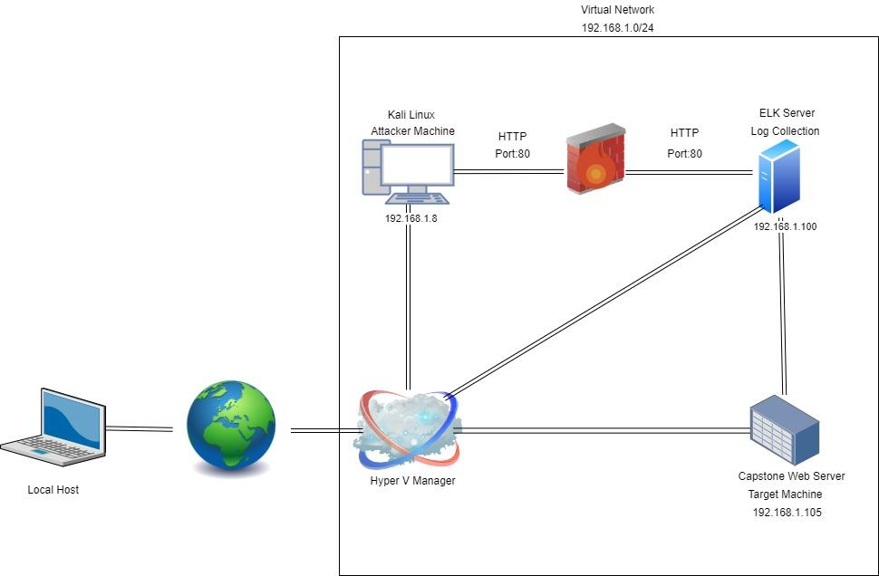
Network Topology
Network
Address Range: 192.168.1.0/24
Netmask: 255.255.255.0
Gateway: 192.168.1.1
Machines
IPv4: 192.168.1.1
OS: Windows
Hostname: Hyper-V Manager
IPv4: 192.168.1.8
OS: Kali Linux
Hostname: Kali
IPv4: 192.168.1.105
OS: Linux
Hostname: Capstone
IPv4: 192.168.1.100
OS: Linux
Hostname: Elk

Slide 5

Red Team
Security Assessment
‹#›

Slide 6
Recon: Describing the Target
Nmap identified the following hosts on the network:
Hostname | IP Address | Role on Network
Capstone | 192.168.105 | Target Machine using the apache webserver
ELK | 192.168.1.100 | Centralized logging service to identify problems in a server or application
Hyper V Manager | 192.168.1.1 | GUI management tool used for administration and configuration of of virtual machines
Kali | 192.168.1.8 | Attacking Machine

Slide 7
Vulnerability Assessment
Vulnerability | Description | Impact
Sensitive data exposure | Files with sensitive information should be restricted. | Unprotected files referenced a secret folder that lead me directly to it. The user account required for “secret_folder” was also referenced in an unprotected folder revealing accounts and further instructions to access sensitive data.
CWE-307: Improper Restriction of Excessive Authentication Attempts | No limit on amount of failed login attempts | This will allow the attacker to run dictionary based attacks to obtain credentials.
CWE-434: Unrestricted Upload of File with Dangerous Type | The software allows the attacker to upload or transfer files of dangerous types that can be automatically processed within the product's environment. | The server allowed files (exploitproject2.php) to be uploaded via webdav. This allowed the attacker to drop in the reverse shell payload
The assessment uncovered the following critical vulnerabilities in the target:

Slide 8
Exploitation: [Sensitive Data Exposure]
01
02
Tools & Processes
How did you exploit the vulnerability?
Used Nmap to confirm it’s a webserver and then proceeded to the server’s address where additional files containing sensitive information was shown.
Achievements
What did the exploit achieve?
Exploit allowed me to traverse the file system to a confidential folder and login that stores User’s credit card and security information.

Slide 9
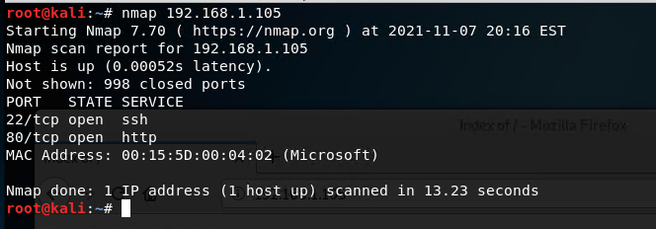
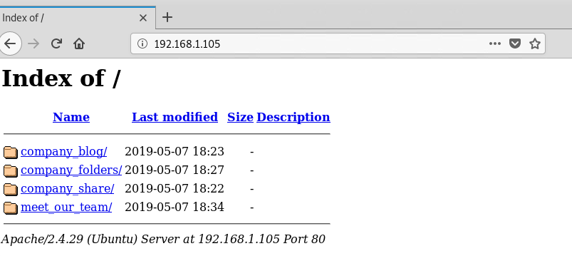
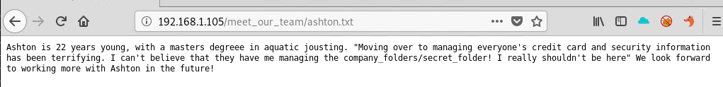
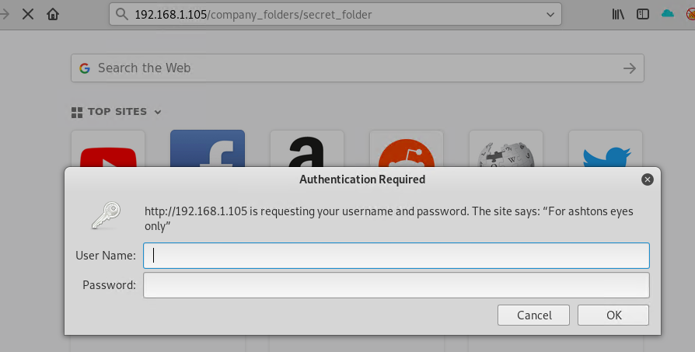
Exploitation: Sensitive Data Exposure
03
Figure 1
Figure 2
Figure 3
Figure 4

Slide 10
Exploitation 2: CWE-307: Improper Restriction of Excessive Authentication Attempts
01
02
Tools & Processes
How did you exploit the vulnerability?
Used Hydra to find matching login and password pair:
<hydra -l ashton -P /usr/share/wordlists/rockyou.txt -s 80 -f -vV 192.168.1.105 http-get /company_folders/secret_folder>
Achievements
What did the exploit achieve?
The exploit gave me elevated access to the victim machine, so we could access the secret folder.

Slide 11
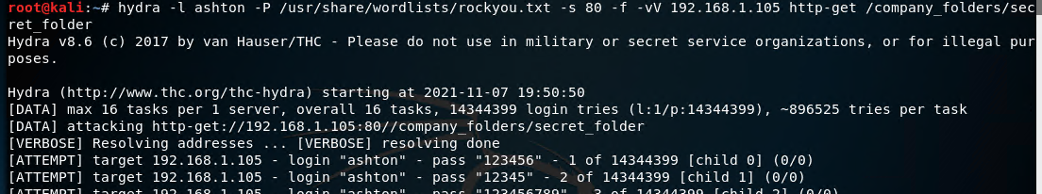
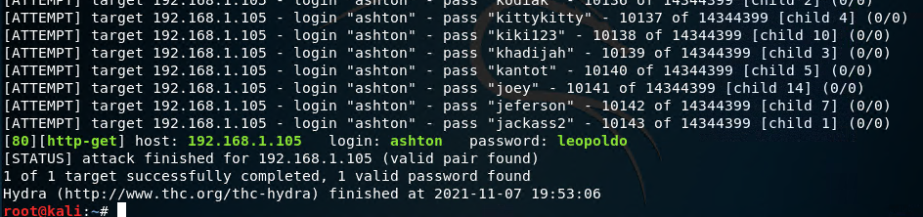
Exploitation Screenshot/Commands: CWE-307: Improper Restriction
03
Figure 1: Command Used
Figure 2: Result

Slide 12
Exploitation: CWE-434: Unrestricted Upload of File with Dangerous Type
01
02
Tools & Processes
How did you exploit the vulnerability? Which tool (Nmap, etc.) or techniques (XSS, etc.) did you use?
Used mfsvenom to create an executable php file.
Achievements
What did the exploit achieve? For example: Did it grant you a user shell, root access, etc.?
The executable file granted me a reverse shell connection

Slide 13
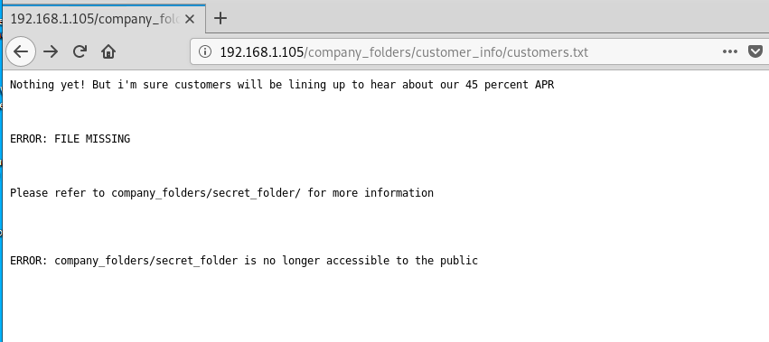
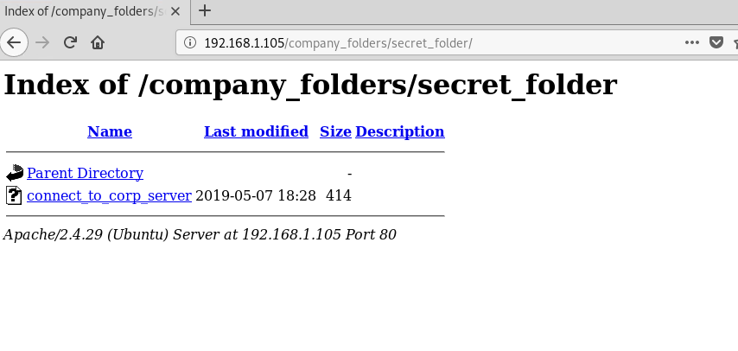
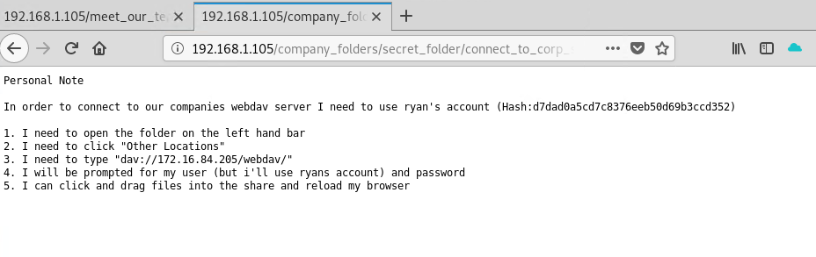
Exploitation: CWE-434: Unrestricted Upload of File with Dangerous Type
03
Figure 1
Figure 2
Figure 3
Figure 4

Slide 14
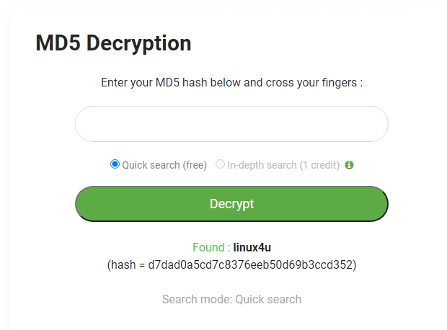
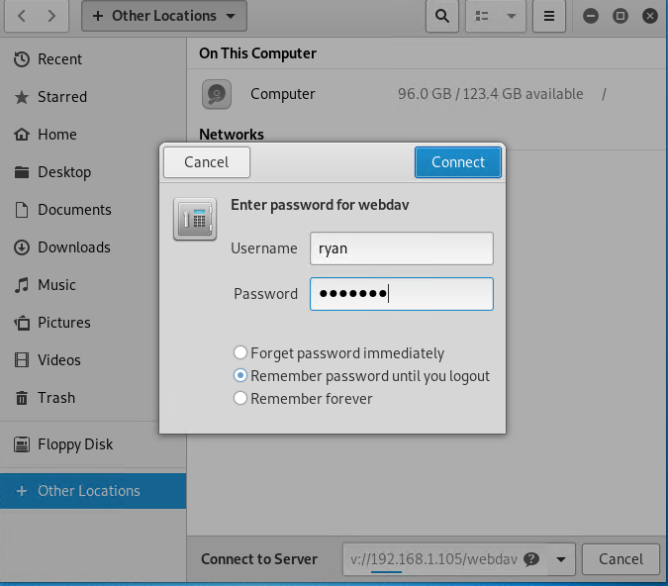
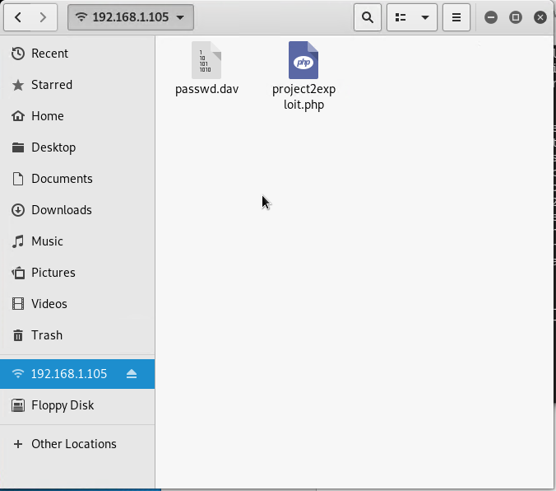
Exploitation: CWE-434: Unrestricted Upload of File with Dangerous Type
03
Figure 5
Figure 6
Figure 8
Figure 7

Slide 15

Blue Team
Log Analysis and Attack Characterization
‹#›

Slide 16

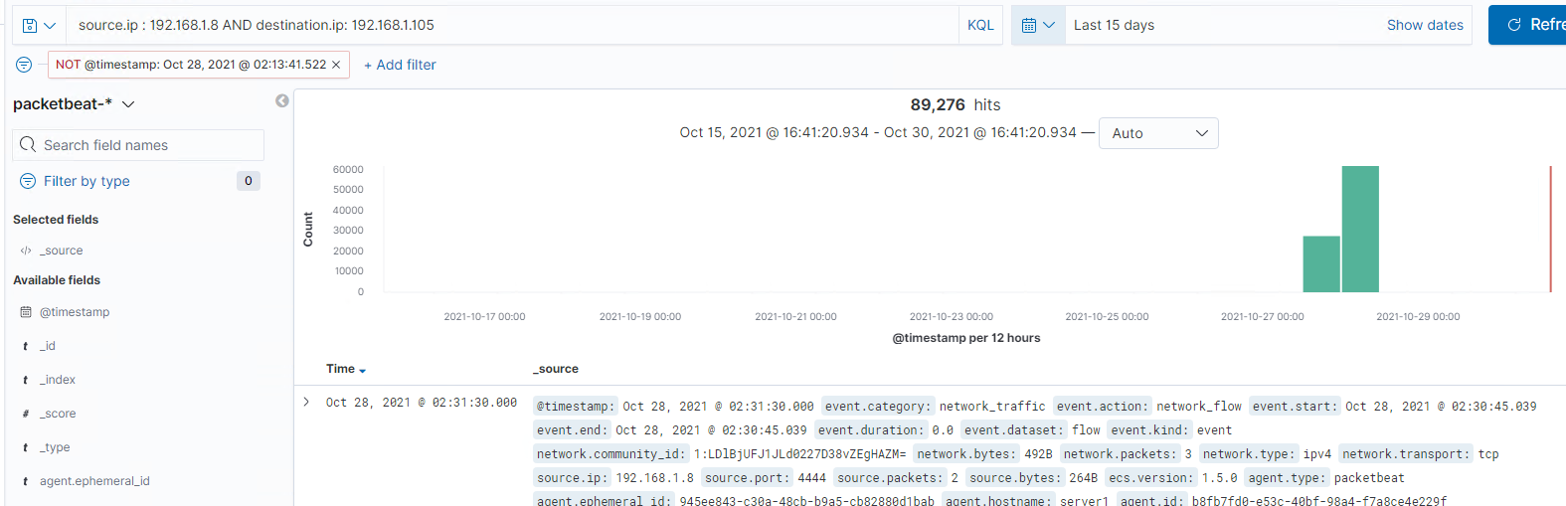
Analysis: Identifying the Port Scan
What time did the port scan occur?
Oct 28, 2021 @ 2:31am
How many packets were sent, and from which IP?
89,276 packets were sent from 192.168.1.8
What indicates that this was a port scan?
A few thousand requests requests all for different ports numbers

Slide 17
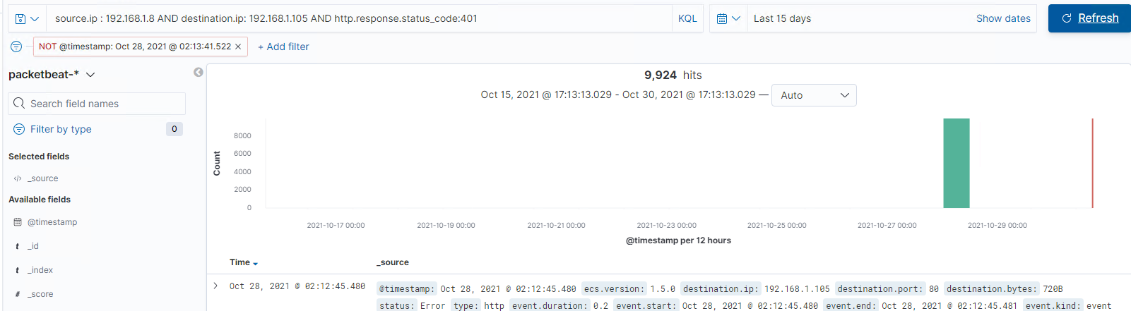
Analysis: Uncovering the Brute Force Attack
How many requests were made in the attack?
9924
How many requests had been made before the attacker discovered the password?
9234. Once the attacker discovered the password, the requests stopped.

Slide 18
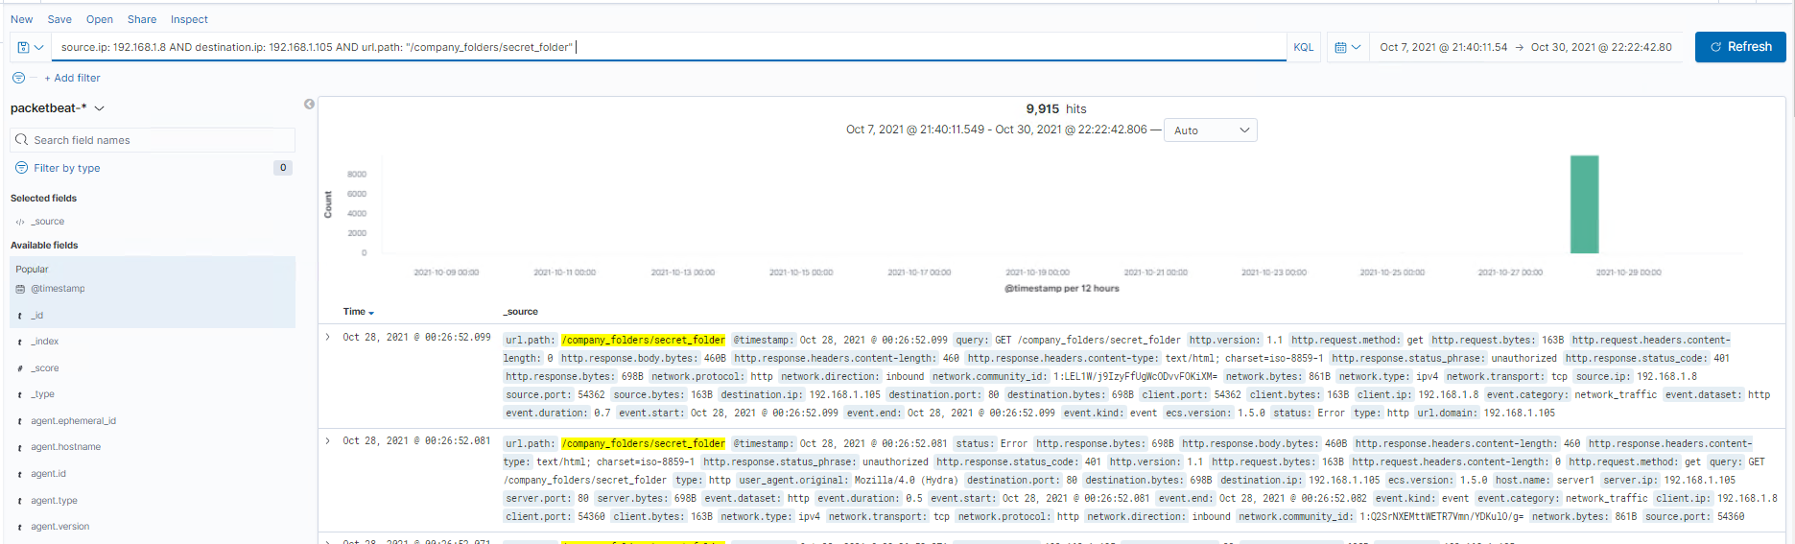
Analysis: Finding the Request for the Hidden Directory
What time did the request occur? How many requests were made?
Request Oct 28, 2021 00:26:52.
9915 requests were made.
Which files were requested? What did they contain?
The secret folder contained instructions on how to access the webdav using Ryan’s account. It also included a hash password.

Slide 19
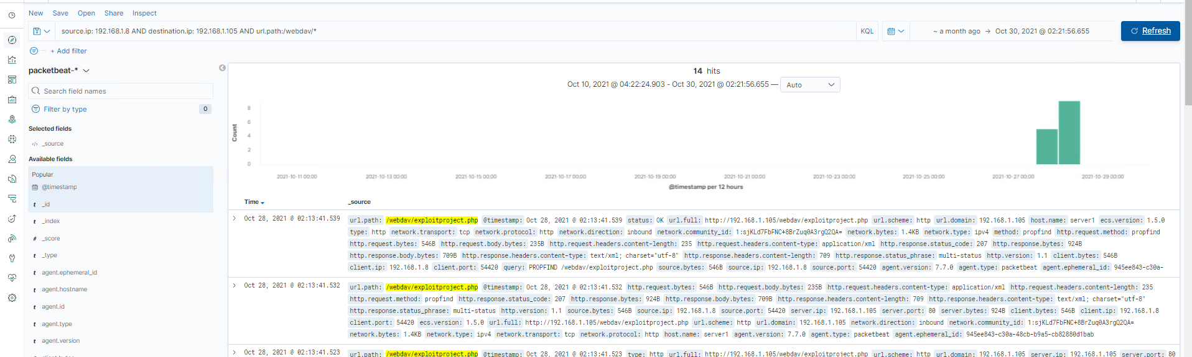
Analysis: Finding the WebDAV Connection
How many requests were made to this directory?
14
Which files were requested?
The exploitproject.php file was requested several times

Slide 20
Blue Team
Proposed Alarms and Mitigation Strategies
‹#›

Slide 21
Mitigation: Blocking the Port Scan
What kind of alarm can be set to detect future port scans?
A filter can be activated if detected traffic from a single source IP address is connecting to different ports.
What threshold would you set to activate this alarm?
Any IP attempting to access closed ports should have the filter activate.
What configurations can be set on the host to mitigate port scans?
Install a firewall. An IPS can detect port scans and shut them down.
Describe the solution. If possible, provide required command lines.
Filtering traffic from an IP triggered by the IPS can effectively mitigate port scans

Slide 22
Mitigation: Preventing Brute Force Attacks
What kind of alarm can be set to detect future brute force attacks?
An alert can be created if 401 Unauthorized is returned from the server over a threshold.
What threshold would you set to activate this alarm?
8 over a 30 minute period to allow forgotten or mistyped passwords.
What configuration can be set on the host to block brute force attacks?
Limit failed login attempts
Limit Logins to a whitelist of IP address
Describe the solution. If possible, provide the required command line(s).
Configure Account policies on your server to limit failed login attempts

Slide 23
Mitigation: Finding the Request for the Hidden Directory
What kind of alarm can be set to detect future unauthorized access?
Any alarm could be set to go off for any IP address not on the whitelist that attempts to access.
What threshold would you set to activate this alarm?
The threshold for this alarm would be 1.
What configuration can be set on the host to block unwanted access?
This directory should not allowed to exist on the server.
Describe the solution. If possible, provide required command lines.
Rmdir -r- this can be used to remove all files and the directory itself from the server.

Slide 24
Mitigation: Detecting the WebDAV Connection
What kind of alarm can be set to detect future access to this directory?
Set an allert for any blacklisted IP attempting to access this directory.
All IPS outside the server range should be blacklisted
What threshold would you set to activate this alarm?
The threshold for this alarm would be set at 1.
What configuration can be set on the host to control access?
Connections to this shared folder should not be accessible from the web and restricted by the machine using a blacklist firewall rule.
Describe the solution. If possible, provide the required command line(s).
Blocking ports 80 and 443
Blacklisting all external IPS

Slide 25
Mitigation: Identifying Reverse Shell Uploads
What configuration can be set on the host to block file uploads?
Remove the ability to upload files from over the web, all file uploads should be from a local source.
Describe the solution. If possible, provide the required command line.
Remove the ability to upload files from over the web. All file uploads should be from a local source. Block port 80,443, and 4444
What kind of alarm can be set to detect future file uploads?
Set an alarm for any php file that is uploaded. Set firewall to block traffic to the shared folder on ports 80, 443, and 4444
What threshold would you set to activate this alarm?
The threshold would be 1

